Slide 1

Loan Prediction
Final Project Presentation
ALY6110: Big Data and Data Management
CRN: 20434
Group Epsilon (Yiwei Wei, Jianming Ma, Sahil Gawande)

Slide 2



Summary
DataBricks
Kaggle
Data size and shape
The whole project is built on Databricks platform, and the programming language used is Python.
The datasource is from LendingClub site, which also can be seen in Kaggle.
Data size is 1.8 GB, which includes 1646801 rows and 150 columns.

Slide 3

Goal
Usage of Big data platform
Understand how big data platforms work and how they operate, such as data import and server startup.
Project aims to figure out how big data platform works and improve the way people manage
their finances
Pre-processing and Exploratory Analysis
Cleaning data and exploring the data insights from Loan 2007-2017
Predictive Analysis
Building a machine learning model to predict the probability that a loan will be paid or charged off.

Slide 4
Data Inputing

Slide 5

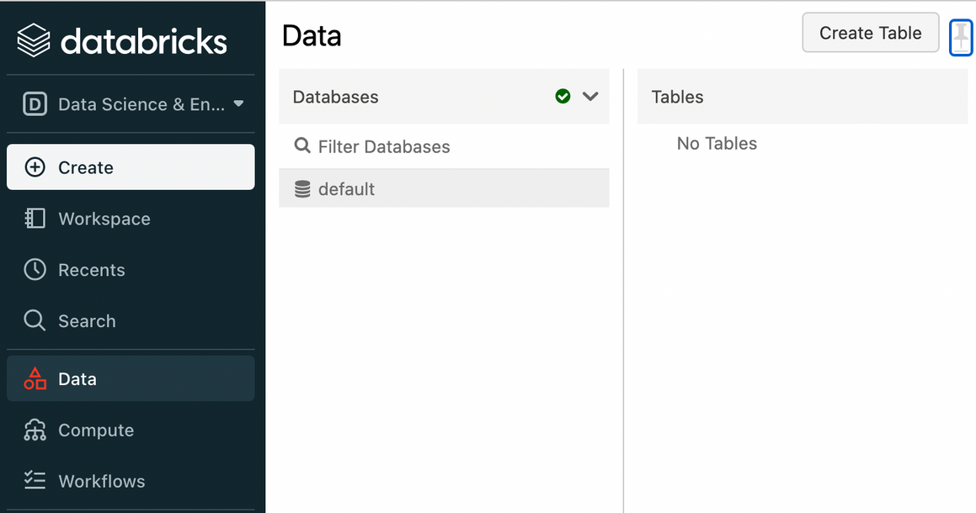
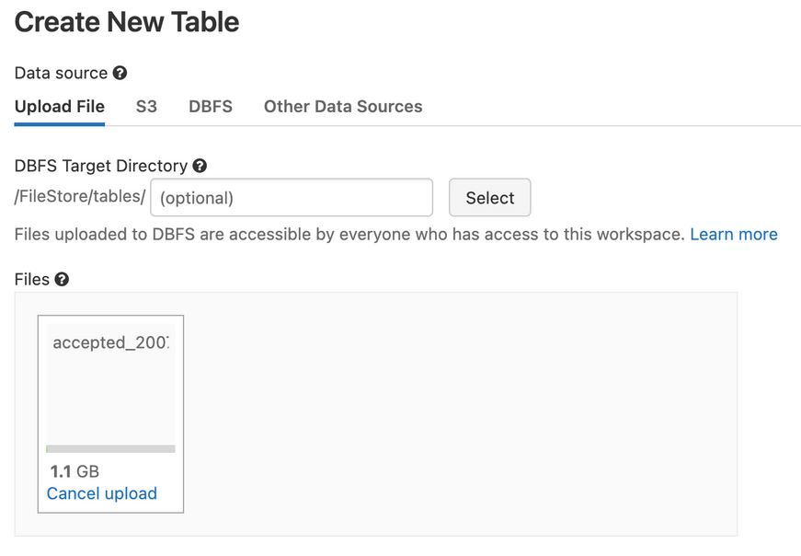
1.Create a table

Slide 6
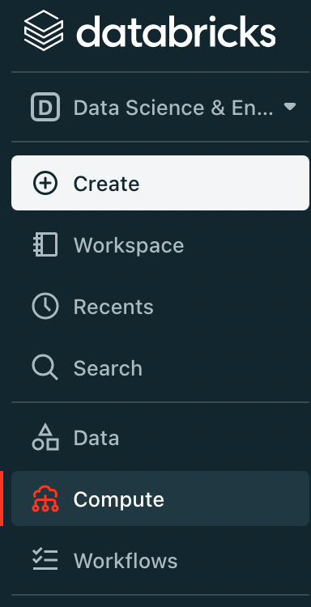
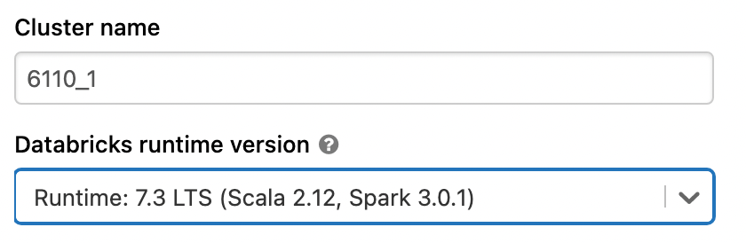
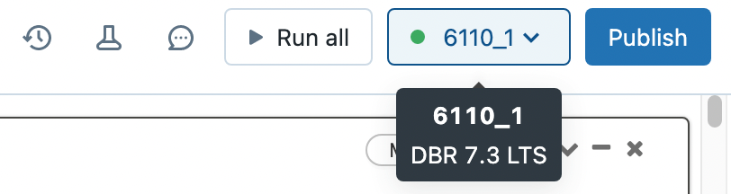
2.Create a cluster

Slide 7
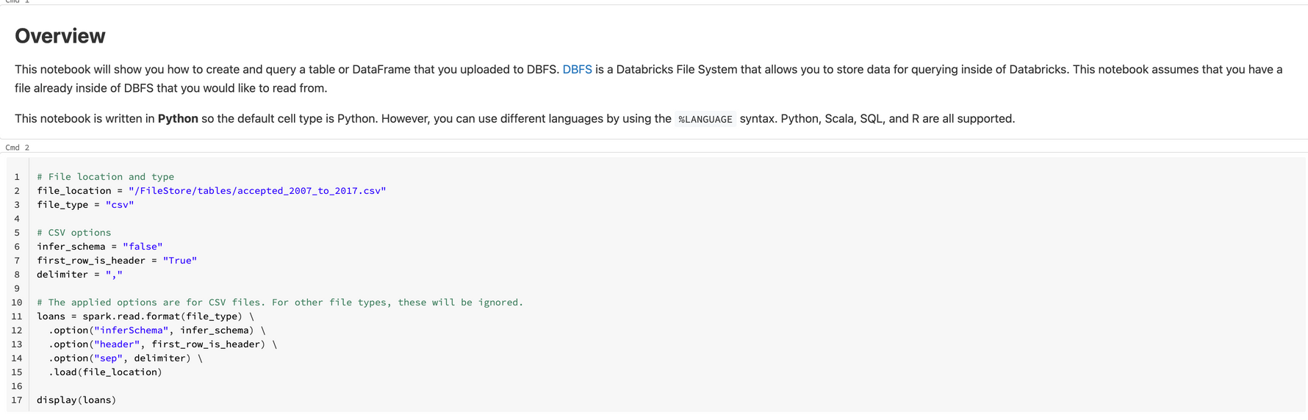
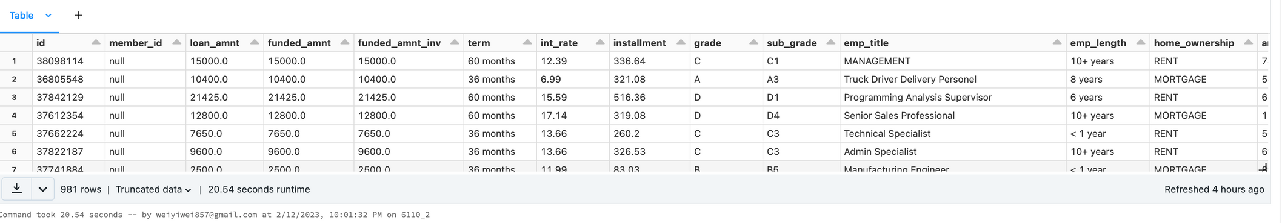
3.Run all

Slide 8
Data Cleaning

Slide 9
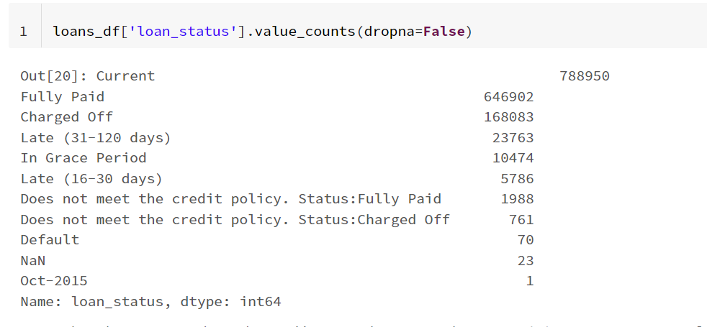
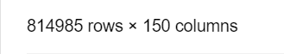
Data Prepare
Filter out the rows and columns related to charge off and pay off.

Slide 10
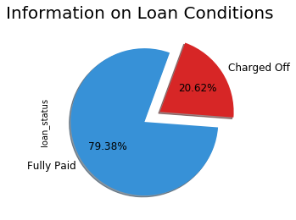
Response
Variable
The purpose of the modeling is to predict the probability that a loan will be paid or charged off.

Slide 11
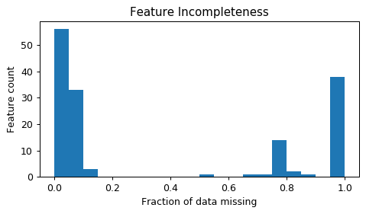
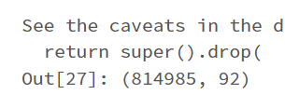
Missing Checking
In this case, we decided to remove features with a missing ratio greater than 40%, which can relatively reduce the number of variables we need to deal with.

Slide 12
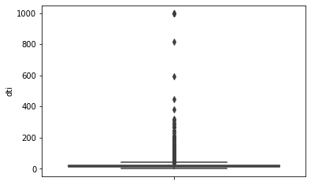
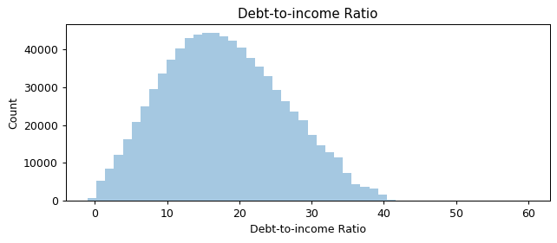
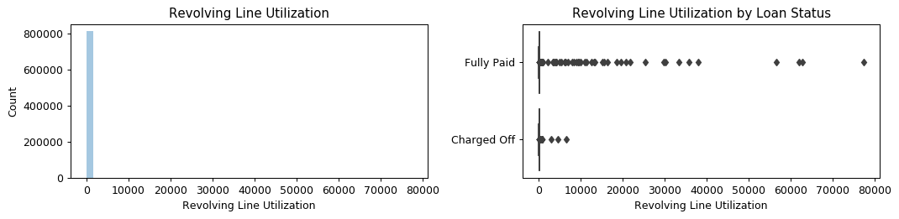
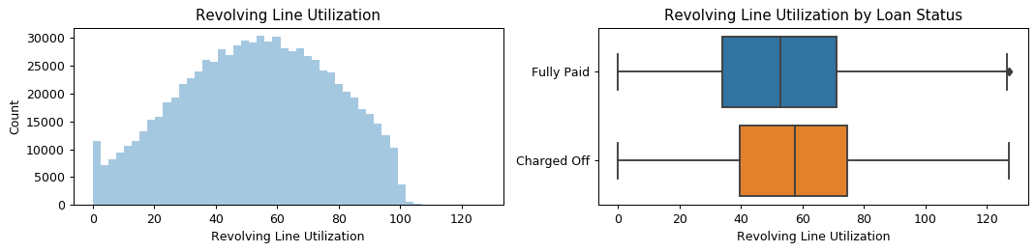
Outlier checking
In this case, we decided to remove outliers with above Q3 + 1.5 IQR for dti and revolving utilization rate, which allow the distribution close to normal distribution.

Slide 13
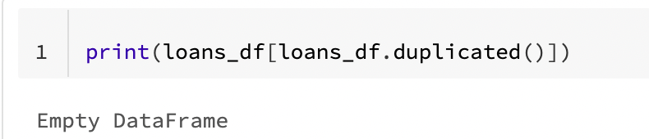
Duplicate checking
After looking through it, we found that there were no duplicate values, so it was not processed.

Slide 14
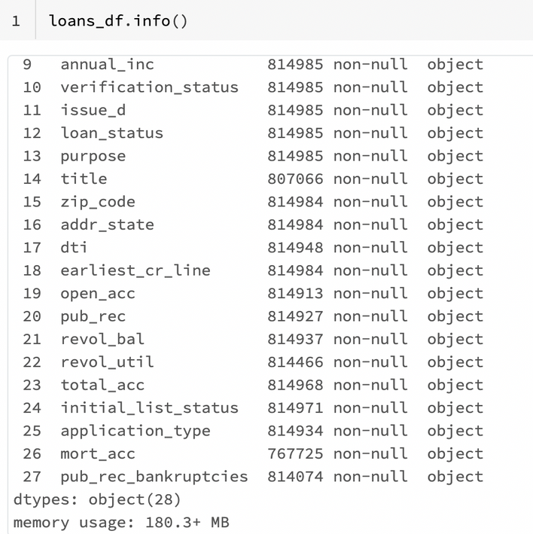
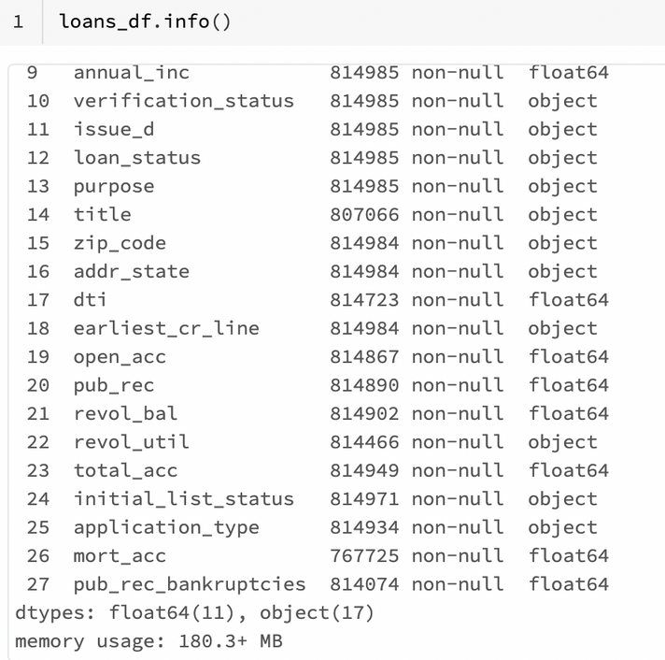
Data format checking
Before
All variables belong to object
Make the data type consistent with the data itself.
After
Pick out the FEATURES that are numeric variables and convert them to data types

Slide 15
Exploratory Analysis

Slide 16
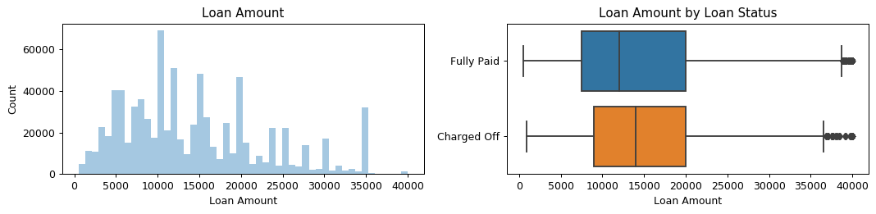
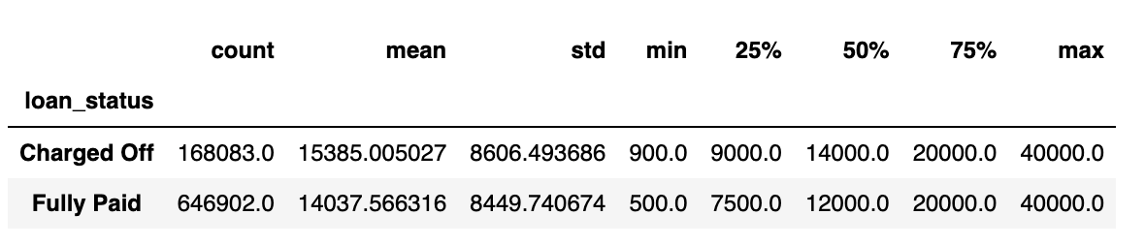
Loan Amont
Charged-off loans tend to have higher loan amounts.

Slide 17
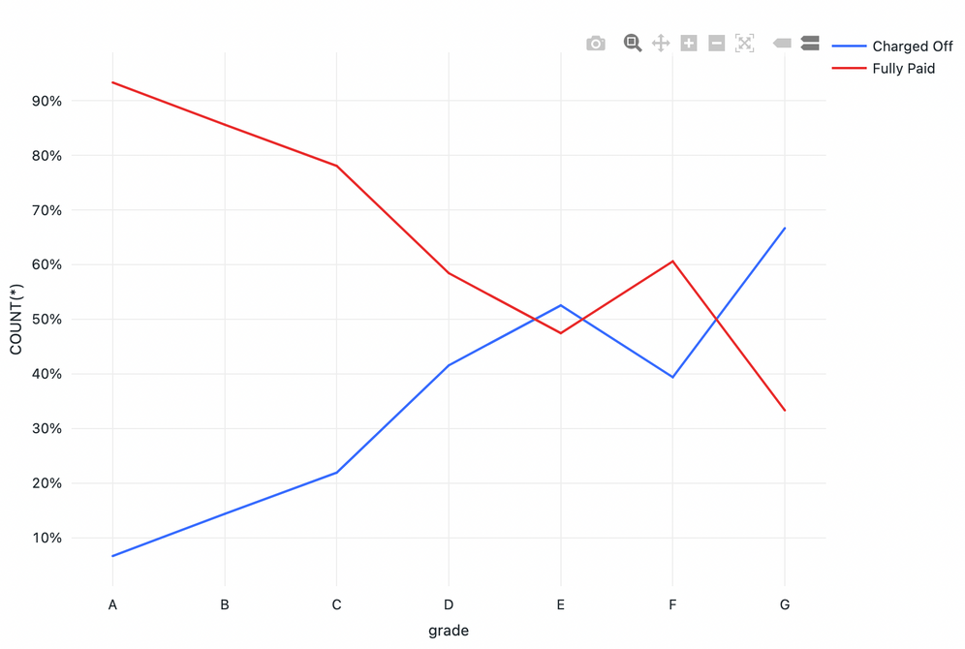
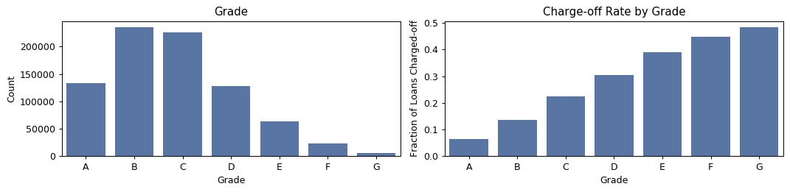
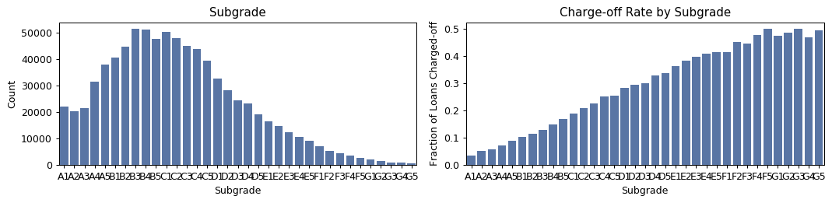
Grade
There's a clear trend of higher probability of charge-off as the grade and subgrade worsens.

Slide 18
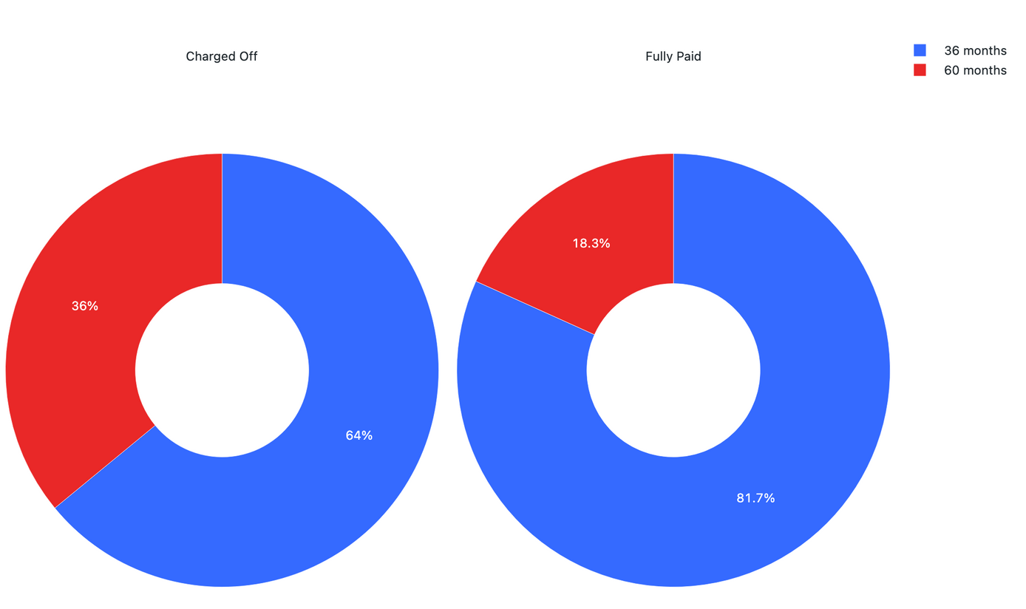
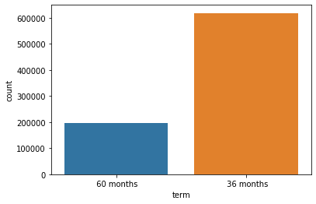
Term
Loans with five-year periods are more than twice as likely to charge-off as loans with three-year periods.

Slide 19
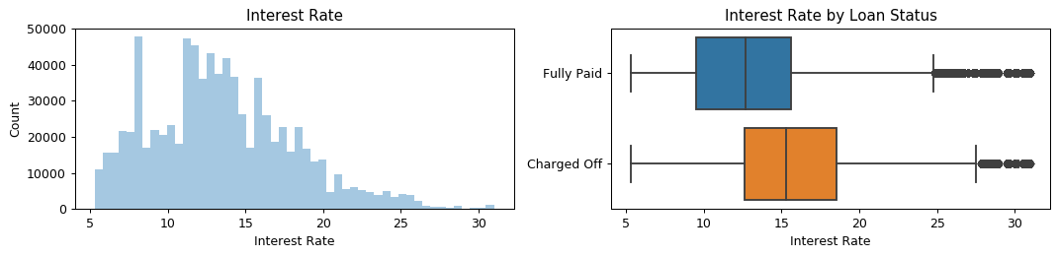
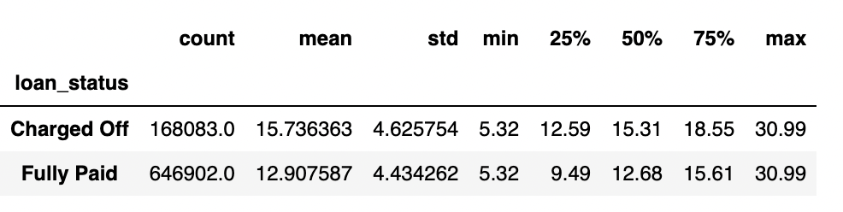
Interest rate
Charged-off loans tend to have much higher interest rates.

Slide 20
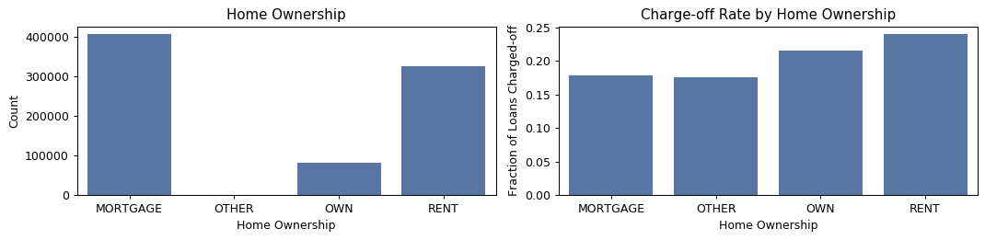
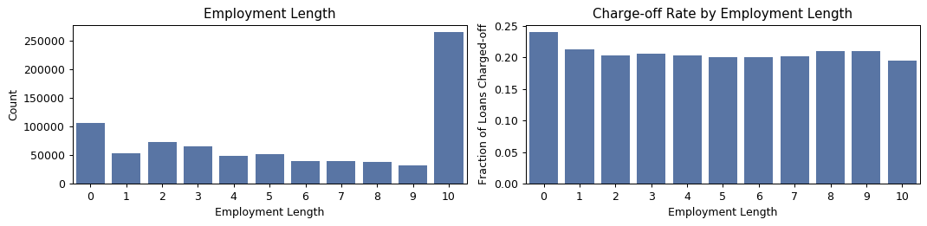
Other features
Renters and homeowners have a higher probability of charge-off.
People without employment length are relatively more likely to be charge-off.

Slide 21
Predictive Analysis

Slide 22
Drop
Feature Engineering
all unimportant features, like subgrade, emp_title, issue_d, purpose, title, zipcode, initial_list_status, addr_state, earliest_cr_line
Convert
Improve machine learning model training, leading to better performance and greater accuracy.
loan status to 0/1 charge-off indicator
missing value to 0
categrorical variables into dummy variables
Transform
the large number variable in a log fucntion
all address states into 5 regions

Slide 23
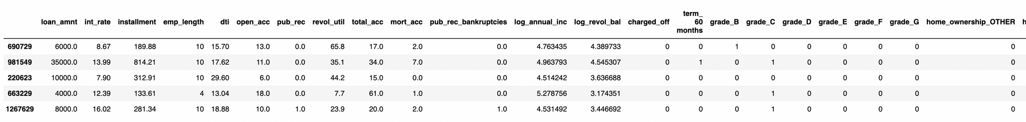
Before Models
01
02
03
Data splitting
Imputing packages
Data Standardization
Randomly assign the training set and test set in 7:3 respectively
Import machine learning libraries, including model library, metrix library.
Use MinMaxScaler() to dimensionlessize the data so that data with different specifications are converted to the same specification.

Slide 24
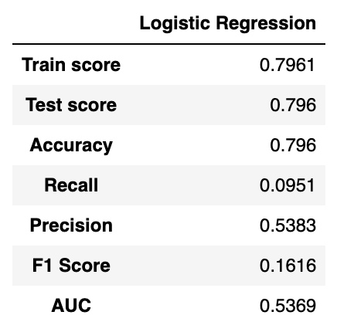
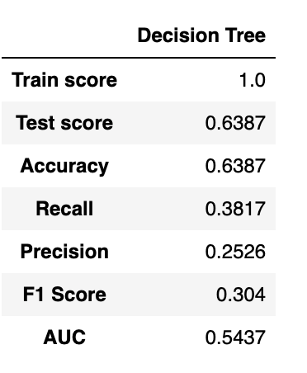
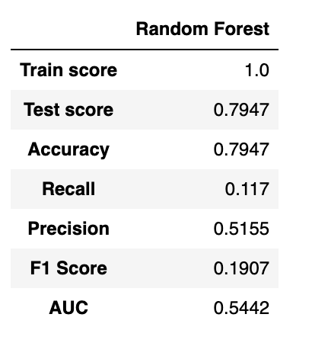

3 Models
Logistic Regression
Decision Tree
Random Forest

Slide 25
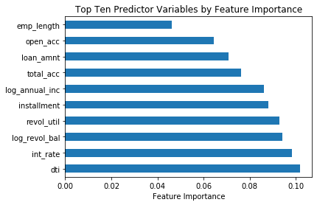
Feature
Importantance
The most important variables for predicting charge-off are the dti, loan interest rate, revolving balance and revolving line utilization rate.

Slide 26
Comments

Slide 27
What we learned
Difficulties
Usage of Big Data Platform
Platform bugs
Advanced data analysis and predictive capabilities
Limitations of visualization
Feature selection
Knowledge of loan finance

Slide 28
Conclusion

Slide 29
Exploratory Analysis
Usage of Databricks
Charged-off loans tend to have much higher loan amounts and interest rates, lower loan grades and with five-year periods term.
This project allows us to familar with the whole process of using Databricks.
4 valuable features
Model selection
The most important variables for predicting charge-off are the dti, loan interest rate, revolving balance and evolving line utilization rate.
Based on AUC space and Precision rate, Logistic regression model is the best.

Slide 30

References
NATHAN GEORGE. (n.d.). All Lending Club loan data. Retrived Jan 30, 2022 from https://www.kaggle.com/datasets/wordsforthewise/lending-club?select=accepted_2007_to_2018Q4.csv.gz

Slide 31
Q&A
Yiwei Wei
wei.yiw@northeastern.edu
Jianming Ma
ma.jianm@northeastern.edu
Sahil Gawande
gawande.s@northeastern.edu

